Slide 1
CONNECTTEL CUSTOMER CHURN PREDICTION
By: Kuro Doumu

Slide 2
Problem Statement
ConnectTel Telecom Company faces the pressing need to address customer churn, which poses a significant threat to its business sustainability and growth. The company's current customer retention strategies lack precision and effectiveness, resulting in the loss of valuable customers to competitors.

Slide 3
Project Objectives
To overcome this challenge, ConnectTel aims to develop a robust customer churn prediction system for which you have been contacted to handle as a Data Scientist. By leveraging advanced analytics and machine learning techniques on available customer data, the company seeks to accurately forecast customer churn and implement targeted retention initiatives.
This proactive approach will enable ConnectTel to reduce customer attrition, enhance customer loyalty, and maintain a competitive edge in the highly dynamic and competitive telecommunications industry.

Slide 4
Importance of Churn Analysis
Retaining customers
Increasing revenue
Easier to retain then source for new customers
Areas to improve to prevent attrition
Identify Strong areas which encourages customer retention

Slide 5
Project Workflow/Overview
Data Cleaning
START
Data Collection
Data Preprocessing
Data Splitting
Model Training
Model Selection
Feature Scaling
Feature Encoding
Feature Extraction
Feature Engineering
Feature Selection
Training Set
Test Set

Slide 6
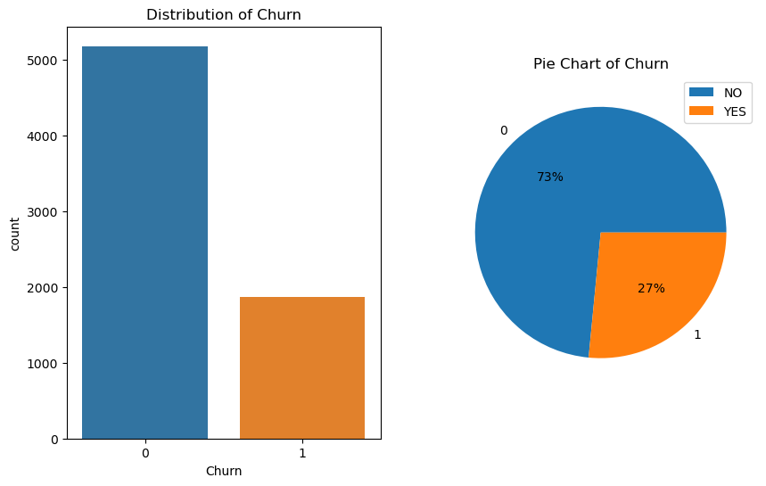


Observations
Attrition Rate
27%
Retention Rate
73%

Slide 7
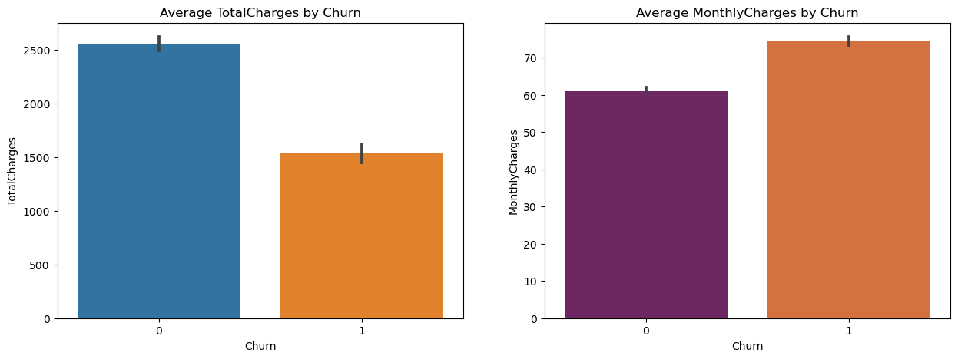
Observations Cont.
TotalCharges
Customers with a higher average TotalCharges churn signifcantly less likely.
MonthlyCharges
Here, customers with more charges churn more than.
The reason would be because month-to-month contracts have the highest churn rate amongst contract types, therefore their MonthlyCharges would be more than

Slide 8
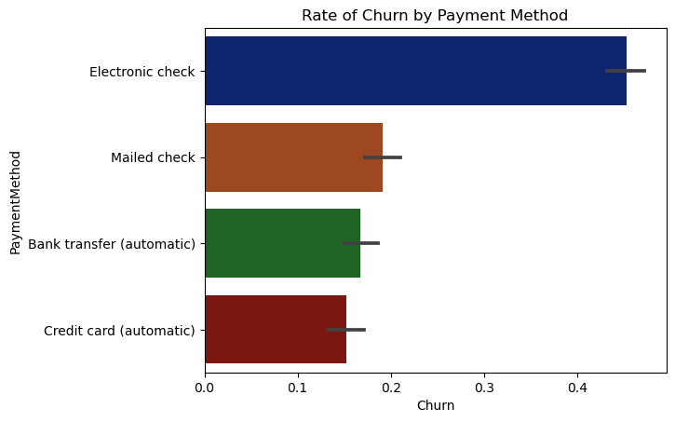
Observations Cont. (Payment Method)
Payment Method
About a 45% churn rate for Electronic Check customers
This is more than double the rate compared to the others
Mailed Check-19%, Bank Transfer-17% and Credit-Card-15%
The transactions with the automatic payments have the lowest rates
Electronic Check having the highest rates could suggest the numerous steps in sending e-checks are tiring for the customers.

Slide 9
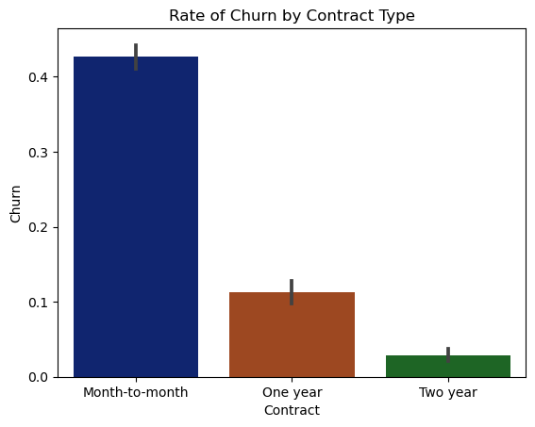
Observations Cont. (Contract Type)
Contract
Month-to-Month contracts have the highest rate of churn at 43%
One-year contracts had 10%
Whilst 2-year contracts had the lowest with under 5%
The longer your contract the more less likely to churn the customer is

Slide 10
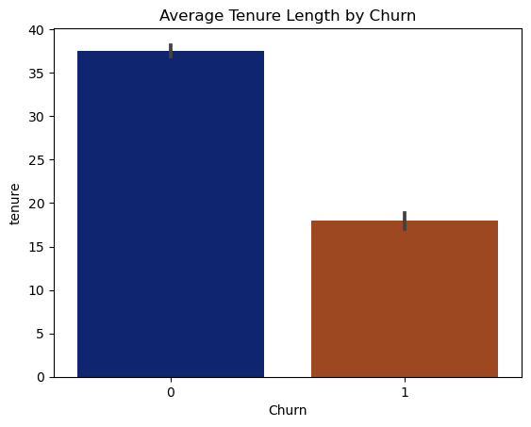
Observations Cont. (Tenure)
Tenure
The longer the tenure of a customer the more likely he remains as a customer
Longer contracts would increase the tenure and likelihood a retaining a customer

Slide 11
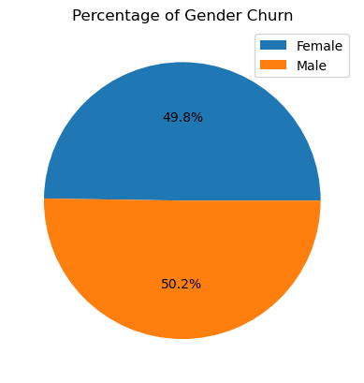
Observations Cont. (Gender)
Gender
There is just a 0.4% difference between females who churn and males who churn. Females 49.8 | Males 50.2
Therefore there is no disparity in customer attrition based on Gender

Slide 12
Models Tested and Trained
Logistic Regression
Extreme Gradient Boost
Decision Tree
Random Forest
Support Vector Machine
Gaussian Naïve Bayes

Slide 13
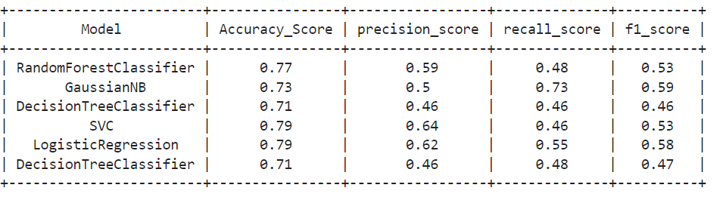
Model Evaluation

Slide 14
Model Evaluation
Insights
Gaussian Naïve Bayes and Logistic Regression have the highest f1 score of 0.59 and 0.58 respectively which is the harmonic mean of the precision score and the recall score, so they have the best balance in predicting True Positive values from the dataset.
Logistic Regression and Support Vector Machine have the highest accuracy of 0.79 score as it was able to correctly predict the most amongst the models

Slide 15
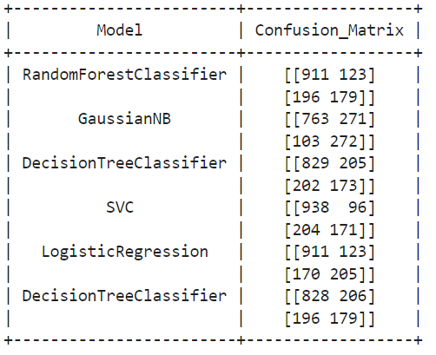
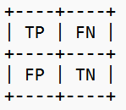
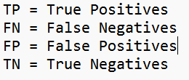
Model Evaluation (Confusion Matrix)
From the confusion matrix we can see that Gaussian Naïve Bayes has the most True Positives of 272 and also the least False Negatives with 103.
Random Forest was able to predict the most True Negatives with 914, closely followed by Logistic Regression with 911.
LABELS

Slide 16
Model Selection
I would recommend the Gaussian Naïve Bayes model in prediction. My reasons being that in churn prediction, it is very important to limit your False Negatives, as predicting customers who are leaving is going to incur most cost on the companies behalf as it is more cost effective to retain existing customers, rather than integrating and sourcing for new ones.
Since the Naive Bayes has the lowest amount of False Negatives and also has the highest True Positives, it is the best in predicting customers who are not churning and also the best at limiting false predictions for customers who are not churning. It also had the highest roc_auc score of 0.73

Slide 17
Recommendations
Dataset should include more demographic feature of customer to help properly understand the customer base and to also be able to group customers in clusters based on their demographic features.
Do educational campaigns to enable customers know about the most recent and best technology released by company
Do campaigns on the benefit of a longer contract to encourage customers to commit more time and money
Undertake customer surveys to have a good understanding on the satisfaction level of customers.

Slide 18
Thank You!!

